Slide 1
Intro to Linux 1
Team or presenters name
Date:
Location: DUB

Slide 2




Virtual Housekeeping
Use
Headsets
Go on
Mute
Participate Actively
Minimize Distractions
Notes:
***Please ensure you have your headset plugged in so we can avoid echoing and maintain audio quality
***Throughout the session, please keep your mic on mute to avoid background noise during the presentation portions.
***Please be aware you will be asked to participate and engage throughout the session. We ask that you are fully active in the chat box, and are also ready to be called on and unmute if needed. We’ll also have you click on some links to view videos, participate in polls and at some point during the session, we’ll be sending you to specific break out rooms depending on which service you’ll be shadowing.
***Lastly, we ask that you’re fully present. Keeping engaged is even more difficult in a virtual setting, so make sure you turn off notifications, maybe set an out of office in your email. Minimize distractions

Slide 3
Course objectives
What is Linux
Shell/bash
File system structure
Command Line Basics
Bash concepts

Slide 4
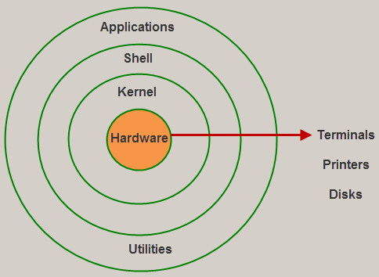
What is Linux?
Notes:
Actually ask the question to the audience

Slide 5
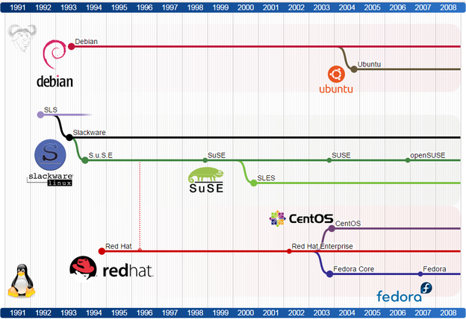

Linux Overview
Notes:
1- The moment you google “What is Linux”? This is the first definition you’re going to see.
Ask the audience if they think this is the right definition?
Linux is the best-known and most-used open source operating system. As an operating system, Linux is software that sits underneath all of the other software on a computer, receiving requests from those programs and relaying these requests to the computer’s hardware.
Originally developed as free open source operating system kernel 1991 by Linus Torvalds.
Based on Unix, which is even older (early 1970s)
All operating system but Windows do derive from Unix, for example:
Mac OS, FreeBSD, OpenBSD,AIX,Solaris,HP-UX and many more

Slide 6
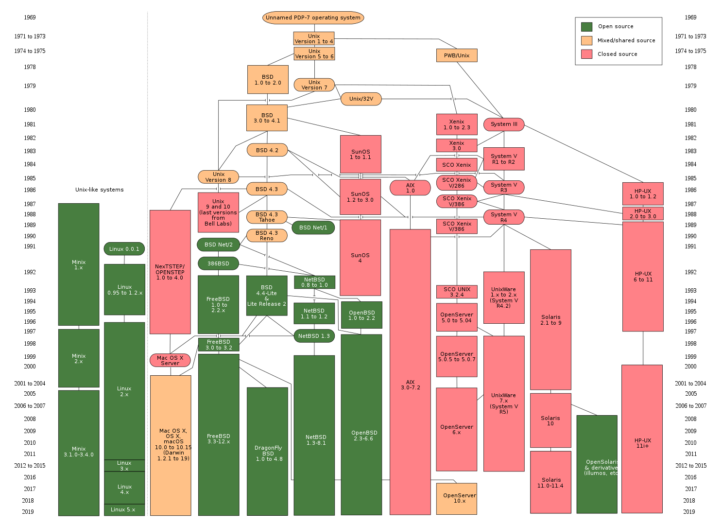
Notes:
Just used as a quick overview to show the impact of Unix.
Thankfully we only have to care about the very small Linux partion of this diagram (linux 2.x to 5.x)

Slide 7
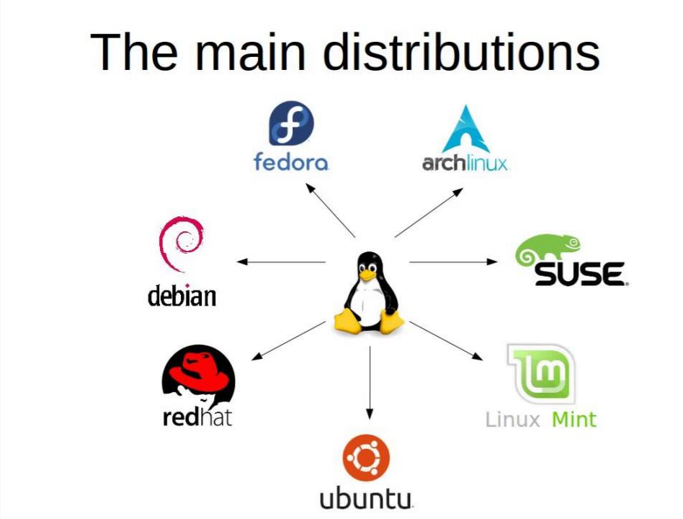
Linux Distributions
Based on:
Red Hat
Suse
Debian
Notes:
But even this kind of bare "GNU/Linux" system is not very useful without the software you want to run on it.
Therefore some distributions (like Debian, RedHat, SuSE, Arch, etc.) went to package a Linux kernel, the GNU tools, and all kind of applications together for easy installation and maintenance.
All Linux distributions are based on the Linux kernel but have their own collection of software which make up the Linux operating system
Q. What are the different distributions/Flavors of Linux?
Q. How many of these distributions have you worked with?
Talk about the various distributions, mention the most common ones – Apt-get, Yum based, Debian, Zypper Talk about CentOS, Raspbarrian etc.
Before moving to next slide:
Q. Have you installed Linux before? On a VM or on bare-metal?

Slide 8
Shell/Bash
Shell is the command interpreter
Command prompt/powershell (windows)
Different UNIX shells ( bash, sh, ksh )
Bash is the default shell in many Linux distributions
Can be set for every user independently
Notes:
But even this kind of bare "GNU/Linux" system is not very useful without the software you want to run on it.
Therefore some distributions (like Debian, RedHat, SuSE, Arch, etc.) went to package a Linux kernel, the GNU tools, and all kind of applications together for easy installation and maintenance.
Q. What are the different distributions/Flavors of Linux?
Q. How many of these distributions have you worked with?
Talk about the various distributions, mention the most common ones – Apt-get, Yum based, Debian, Zypper Talk about CentOS, Raspbarrian etc.
Before moving to next slide:
Q. Have you installed Linux before? On a VM or on bare-metal?

Slide 9
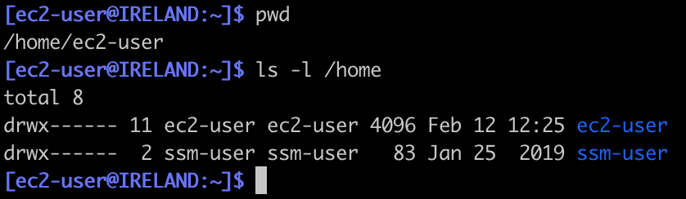
Linux Shell syntax
$ CMD <OPTIONS> <OTHER ARGUMETNS>
Command is the first argument of the shell
Notes:
How can I interact with the Linux Shell?
What kind of command structure does it support, what is the minimum and what is optional?
Q: Can somebody name a few common linux commands?

Slide 10
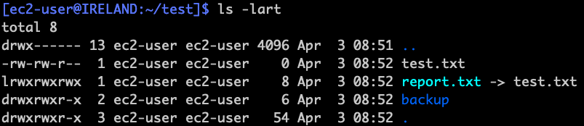
Basic file system objects
- regular file
d directory
l symbolic links
Notes:
Everything is a file in linux…even directories

Slide 11
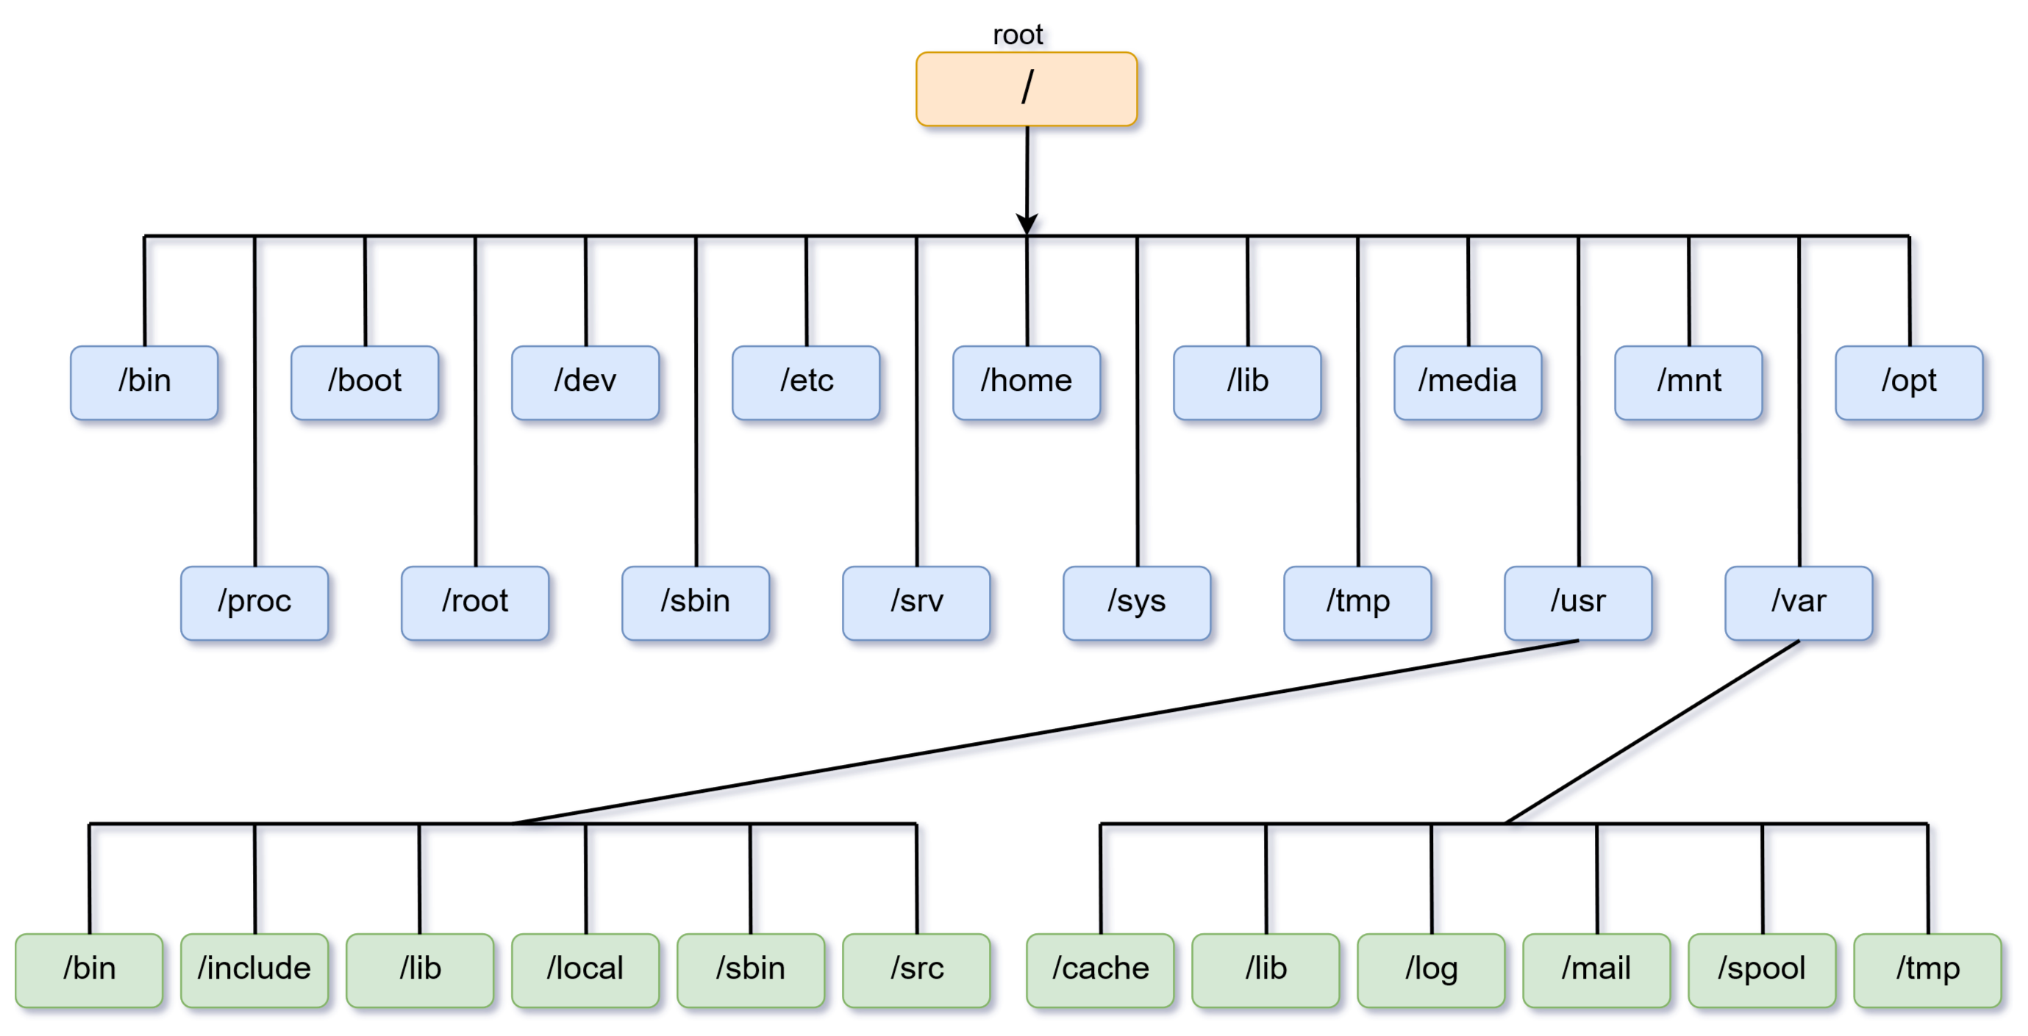
File system structure

Slide 12
Relative and Full File paths
All files and directories can be referenced either with the full path or the relative path
Full path start with a /
Everything else is a relative path like ls, ./, ../
Notes:
Q: Ask what they think the difference is between these four commands, what output it does produce and why?
Explain the difference between a full path, no path given, ./ and ../
ls /home/ssm-user
ls
ls ./
ls ../ec2-user
Give practical example on command line

Slide 13
Basic commands for Files
 | Regular file | Directory
Create | touch/vi | mkdir
Copy | cp | cp -R
Move/rename | mv | mv
Delete | rm | rmdir/rm -r
Notes:
Do a little question round to see what basic commands they already know
There are many cheat sheet with the basic Linux commands, but you might want to make your own little text file to start with
https://www.google.com/search?q=linux+command+cheat+sheet

Slide 14
File Permissions and Ownership
List file permissions and ownership
ls -l data_file
-rwxrw-r-- 1 ec2-user staff 3 Apr 15 16:59 data_file
rwxrw-r-- File Permissions
ec2-user Owner
Staff Group
rwxrw-r--
rwx Owner (read,write,execute)
rw- Group (read,write)
r-- Others (read)
Change permissions and ownership
chmod 400 data_file
chown user1:group1 data_file

Slide 15
Bash concepts

Slide 16
Wildcards
Allows you to specify names that match a specific pattern
? - represents a single character
* - represents any number of characters
ca? can be car,cat,can,cab…
cd* can be cd,cdrom,cdrecord…
Helps tremendously to efficiently manage files or do scripting
Notes:
Man 7 glob

Slide 17
Variables
Storage address where a symbolic name contains a value
- How to set a variable:
variable=value xvar=hello
- How to use the variable:
echo $variable echo $xvar
hello
`env` shows all variables in bash, for example PATH
Environment / common and global variables
Notes:
Ask audience if they know what variables are?
Explain variables and capital letter naming convention
Environment variables are all displayed via “env”
Common are variable = value
Global are exported variables
explain $PATH

Slide 18
Alias
Replacing a specific command, often used for shortcuts
“ls -l” does get substituted by “ll”
- How to create an alias:
alias alias_name="command_to_run”
alias info="date;id"
- How to display alias:
alias
alias info
Notes:
An alias is a (usually short) name that the shell translates into another (usually longer) name or command.
Aliases allow you to define new commands by substituting a string for the first token of a simple command.
They are typically placed in the ~/.bashrc (bash) or ~/.tcshrc (tcsh) startup files so that they are available to interactive subshells.

Slide 19
Builtin Commands
Commands that are part of the shell (bash) itself and not external
Type ls
Type echo, which echo
Echo is a bultin but also exists in /usr/bin/echo, why?
Notes:
Bash builtin commands (also known as "internal command") are part of the shell itself.
Each builtin command is executed directly in the shell itself, instead of an external programme which the bash would load and run.
For example, the top is an external command, and echo is an internal or builtin command.
echo explanation:
You're not always using a shell. Under a variety of circumstances, you run an executable directly and not through a shell.
At least in theory, some shells don't have an echo builtin. This is not actually required.
find src -name 'abc*' -type f -exec echo mv -nv {} dest/ \;
https://www.gnu.org/software/bash/manual/html_node/Bash-Builtins.html

Slide 20
Command execution
Steps taken in order when a command is issued in bash:
Check if command is alias (if yes substitute)
Check if an absolute path (if no check $PATH)
If relative check $PATH folder in order to find command/executable
Load command or script into memory
Evaluate options and arguments given
Display output to STDOUT/shell (more on STDOUT soon)

Slide 21
Shell expansions
Brace expansion is a mechanism by which arbitrary strings may be generated
The ‘$’ character introduces parameter expansion, command substitution, or arithmetic expansion.
echo a{b,c,d}e
Abe ace ade
$ string=01234567890abcdefgh $ echo ${string:7}
7890abcdefgh
Echo ls
Echo `ls`
Echo $(ls)
Tilde expansion
~ value of $HOME
cat ~/.bash_history
$(( expression ))
a=$(( 4 + 5 ))
echo $a
9
Notes:
Brace expansions, for example for creating a lot of files
Touch test{1..10000}
https://www.gnu.org/software/bash/manual/html_node/Shell-Parameter-Expansion.html#Shell-Parameter-Expansion
Do examples from manual for further expansions

Slide 22
“Quoting”
\ is the escape character
date=Today
echo $date
echo \$date
Double quotes preserve literal value with exception of ‘$’, ‘`’, ‘\’
echo "The date is $date"
Single quotes preserve the literal value (‘)
Echo ‘$date’
Notes:
do a live demo to illustrate different quoting techniques
Also common pitfills: http://mywiki.wooledge.org/BashPitfalls#echo%5f.24foo

Slide 23
Redirect
Stdin(0), stdout(1), stderr(2) are data streams that can be redirected
ls > output.log (redirect output of “ls” to file
ls >> output.log (appends output of “ls” to file
cat <output.log (redirects output.log to “cat” command)
Pipe |
Cat 123.log | grep “error”
$ ls 456.txt >> output.log
ls: cannot access 456.txt: No such file or directory
$ ls 456.txt > output.log 2>&1
$ cat output.log
ls: cannot access 456.txt: No such file or directory
Notes:
There are always three default files open, stdin (the keyboard), stdout (the screen), and stderr (error messages output to the screen).
These, and any other open files, can be redirected. Redirection simply means capturing output from a file, command, program, script, or even code block within a script and sending it as input to another file, command, program, or script.
Each open file gets assigned a file descriptor. The file descriptors for stdin, stdout, and stderr are 0, 1, and 2, respectively.
do practical demo or explain redirects of stdin,stdout and stderr

Slide 24

Tipps and tricks
“history” will display the last commands for this user (~/.bash_history)
Display last command executed
!! Execute last command (sudo !!)
CTRL + r (searches history)

Slide 25
You should now be familiar with…
What is Linux
Shell/bash
File system structure
Command Line Basics
Bash concepts

Slide 26
Practical Exercise 1
Create an EC2 instance (AL2) and connect to it via ssh (putty,terminal)
Do the following
Check which directory you are in
Change the directory to /home/ec2-user
List the contents of the directory including hidden files
Consult manpage of ls to check arguments/flags
Create three directories “superman”,“batman” and “backup”
Change to “superman”
Create a file “gotham” in “batman” without leaving “superman”
List the file “gotham” without leaving “superman”
Move the file “gotham” from “batman” to “superman”
Remove the file “gotham”
Remove the two folders “superman” and “batman”
Leave “backup” for later use
Notes:
https://docs.aws.amazon.com/AWSEC2/latest/UserGuide/AccessingInstances.html

Slide 27
Practical Exercise 2
Do create 100 files with a single command (brace expansion)
Calculate 5 + 5 in bash (arithmetic expansion)
Create a new variable and explore different quoting options (”” , ‘’ , \ )
issue an invalid command and redirect STDERR to a log file
Display the aliases you have configured
Notes:
https://docs.aws.amazon.com/AWSEC2/latest/UserGuide/AccessingInstances.html

Slide 28
Insist on the highest standards
Please take 2 minutes to complete the survey to let us know what you liked about the training and what can be improved.
This will help us to continue creating helpful and relevant training content.
Link is in the invitation email.

